Slide 1

“WE LEARN BETTER WHEN LEARNING IS A GAME””
Given the current world order, HUNGER, ANIMAL CARE and SANITATION are problems of monumental proportions for large sections of our society.
Our game aims to make its players responsible citizens who care about the environment, work on ending hunger and also care for the varied life on land.
Targeted audience for the game is kids in their formative years as such kids tend to impersonate superheroes that they see/play on screen. The world will be a much better place to live if they impersonate our dear protagonist VEDA!!
Gamifying the sustainability of our planet!
Veda goes on a mission to clean the environment, protect animals and end hunger!!

Slide 2
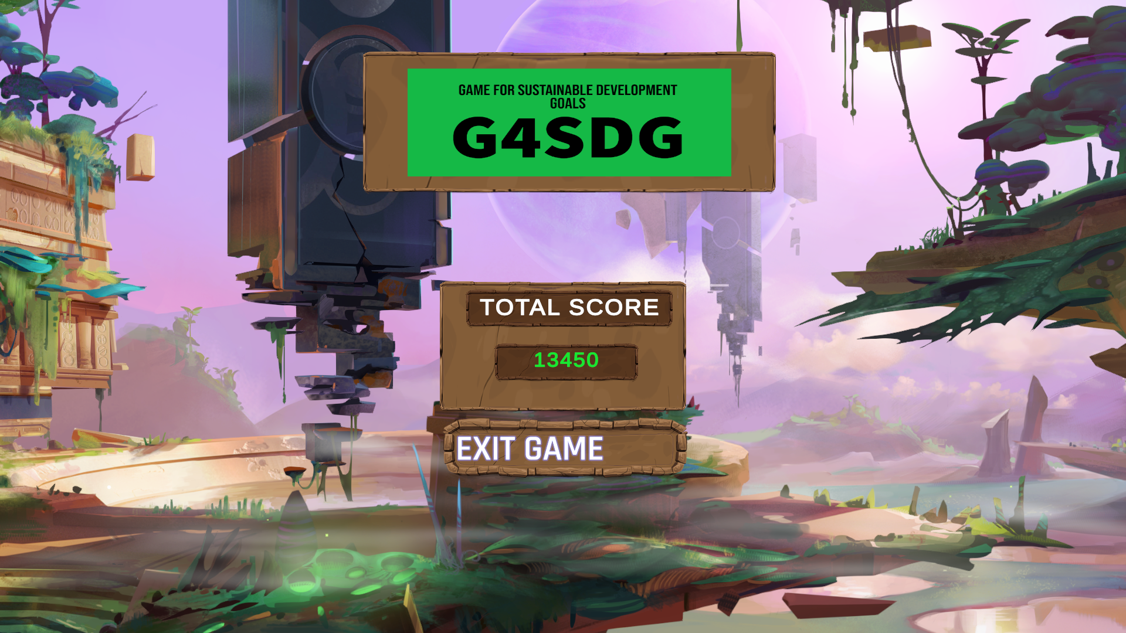
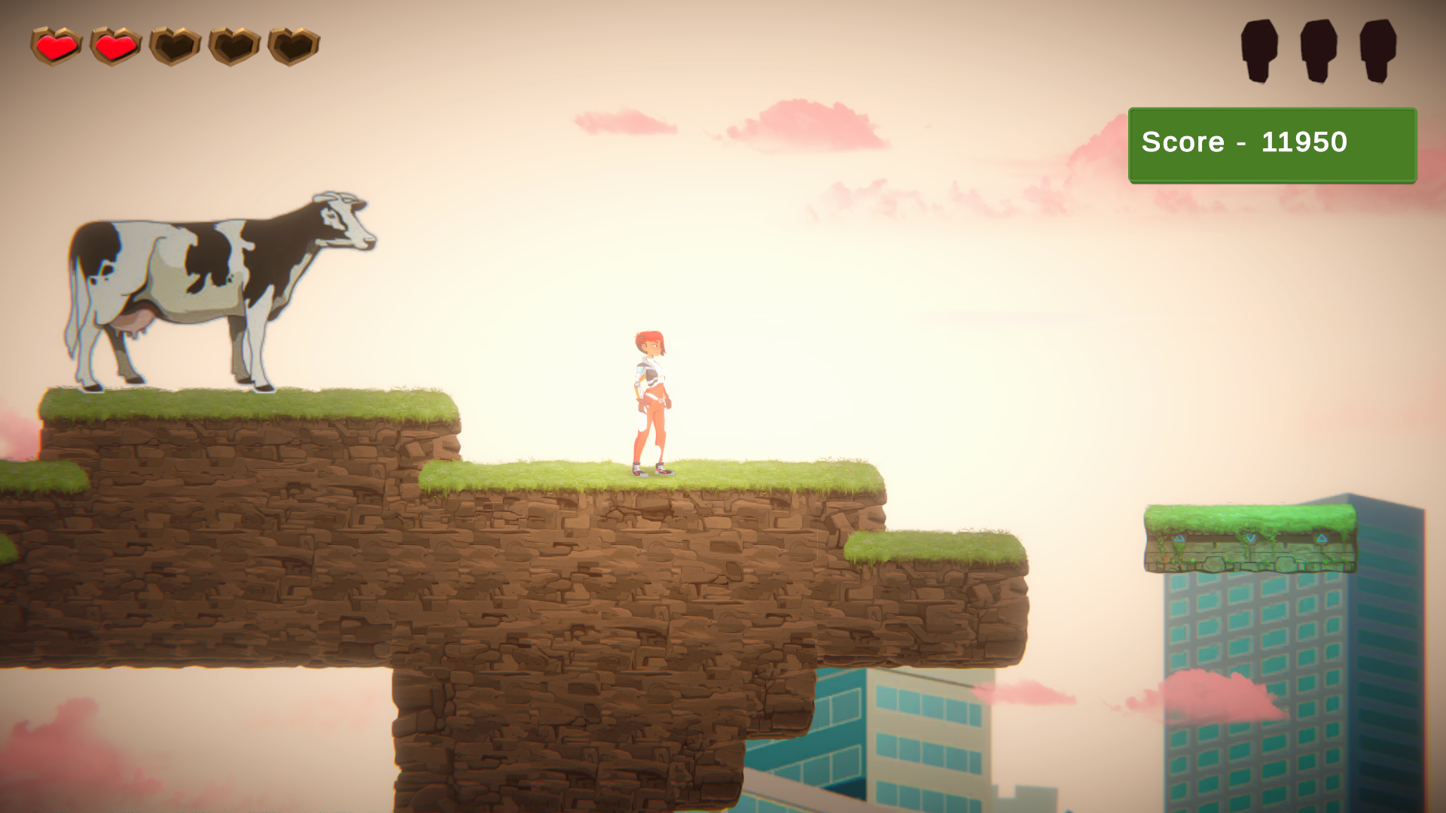
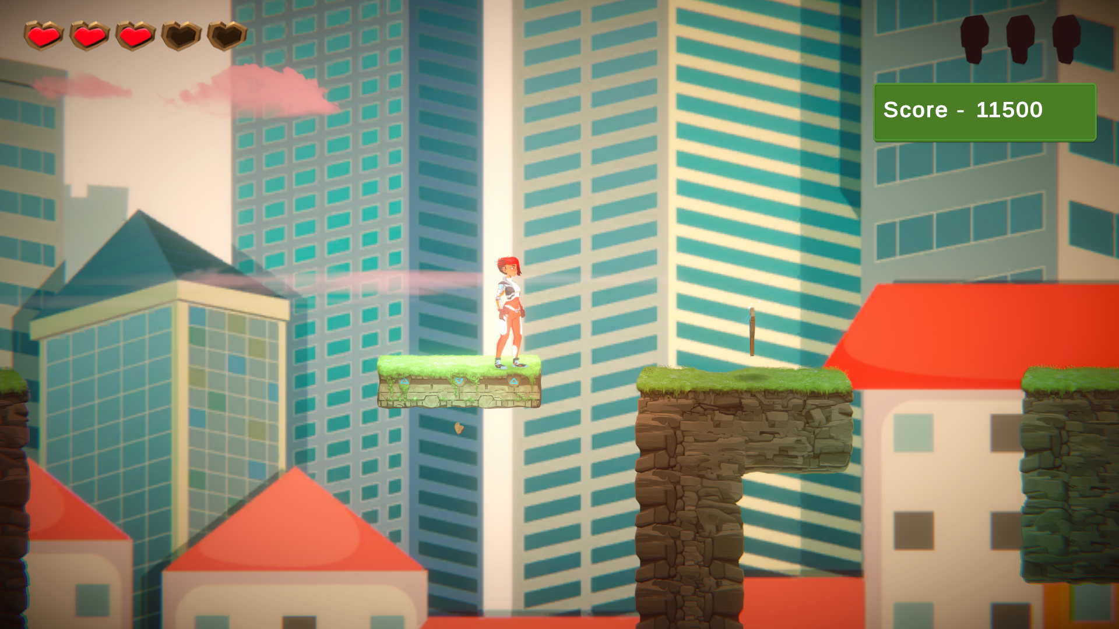
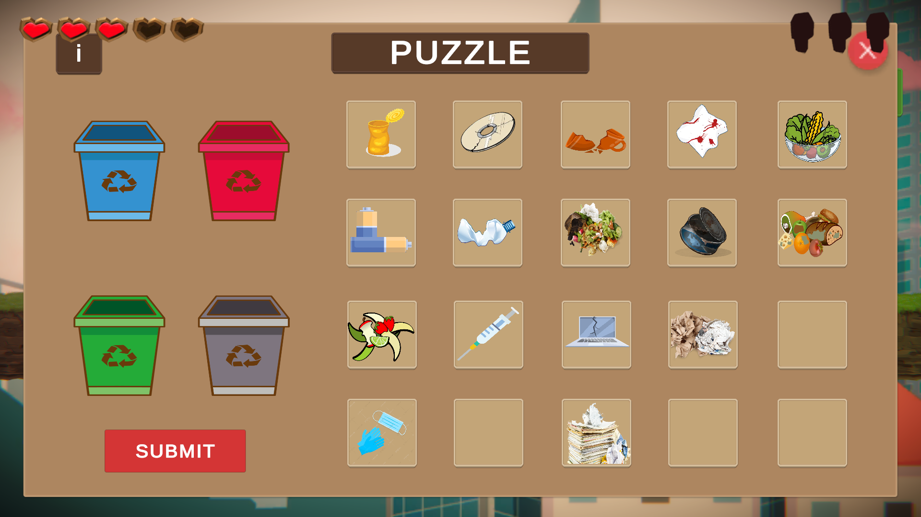
Goals Targeted:
Clean Water and sanitation
Life on Land
Zero Hunger
Any existing solutions so far?
No score based competitive educational games were to be found.
Why does our solution work?
Interactive
Score driven
Multiplayer extension possible

